Slide 1



Slide 2
Digital Store
Bem vindo a nossa loja oferecemos produtos de qualidade, e os últimos modelos do mercado a bons preços, obtemos os produtos diretos de fornecedores oficiais ( Samsung , Lenovo , Apple) .
NB: Todos produtos comprados tem a garantia de 13 meses , a garantia só abrange problemas técnicos e de funcionalidade

Slide 3

New Models

Slide 4


Slide 5
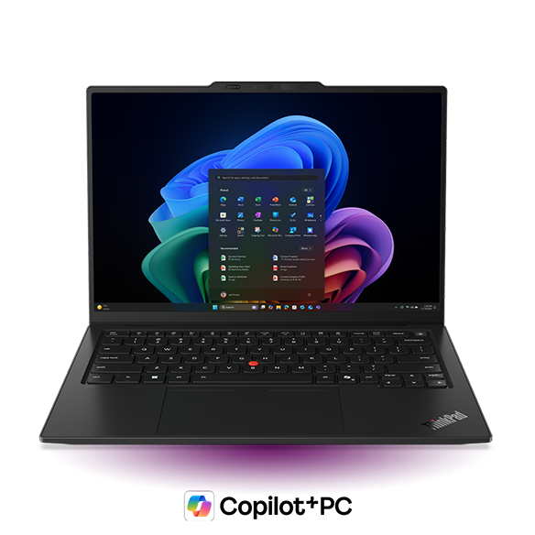
The Lenovo ThinkPad X1 Carbon Gen 14 Aura Edition is an ultra-premium, AI-driven 14-inch business laptop (starting under 1kg/2.2 lbs) designed for high mobility and performance. It features Intel Core Ultra (Series 2 or 3) processors, Copilot+ PC AI capabilities, and a 2.8K OLED display, focusing on user experience, advanced sustainability, and improved repairability

Slide 6
The Lenovo ThinkPad X1 Carbon Gen 14 Aura Edition is an ultra-premium, AI-driven 14-inch business laptop (starting under 1kg/2.2 lbs) designed for high mobility and performance. It features Intel Core Ultra (Series 2 or 3) processors, Copilot+ PC AI capabilities, and a 2.8K OLED display, focusing on user experience, advanced sustainability, and improved repairability

Slide 7
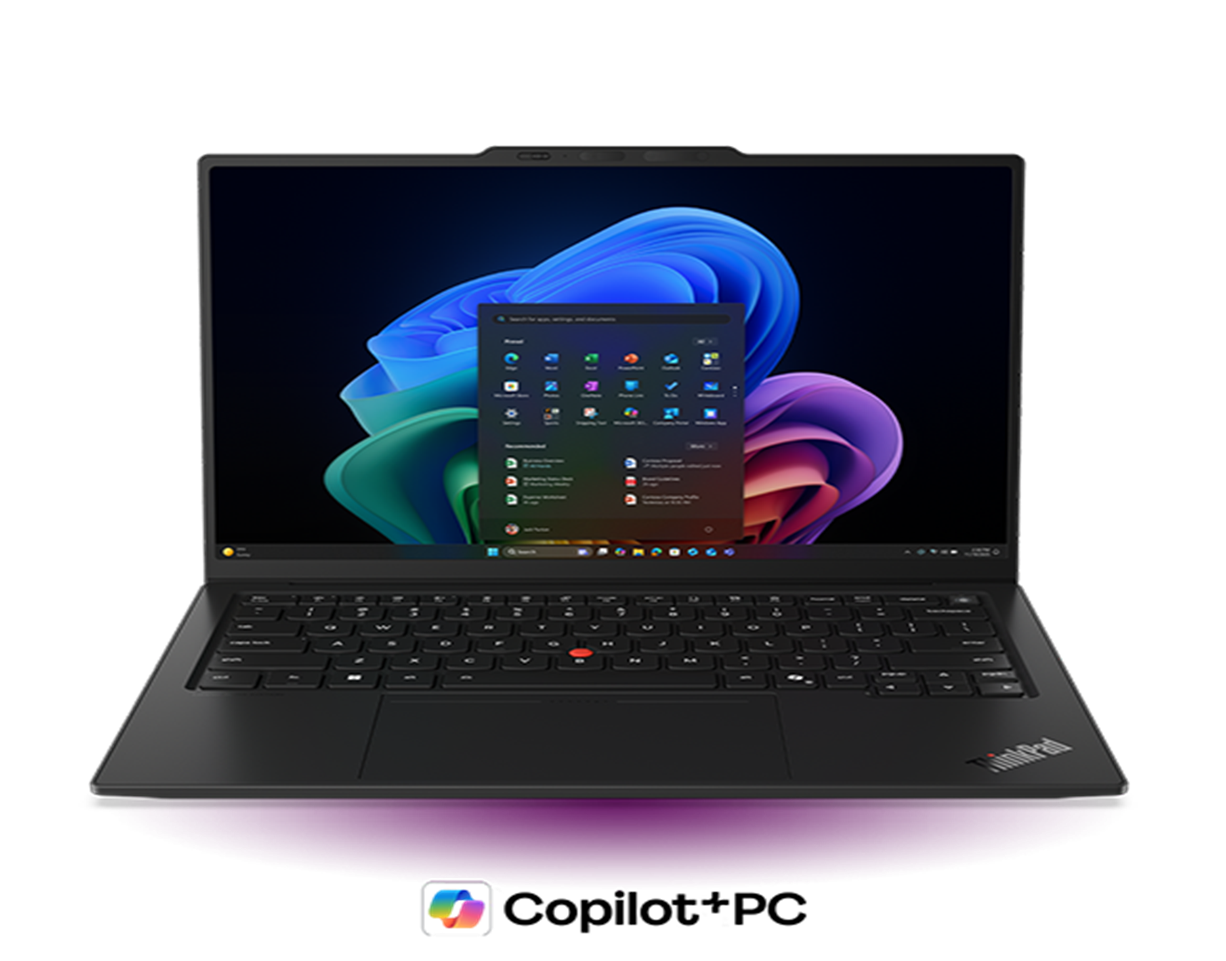
specific
Ultralight 14″ premium business laptop
Aura Edition features for optimized
Experiences & productivity
Optimal performance for enterprise
leaders, IT decision-makers & mobile professionals
Intel® Core™ Ultra 5 335 vPro® Processor (LPE-cores up to 3.40 GHz P-cores up to 4.60 GHz)
Windows 11 Home
Lenovo recommends Windows 11 Pro for busine
integrated Graphics
32 GB LPDDR5X-8533MT/s (Soldered)
256 GB SSD M.2 2280 PCIe Gen4 TLC Opal
14" WUXGA (1920 x 1200), IPS, Anti-Glare, Touch, 100%sRGB, 500 nits, 60Hz, Low Power
5MP RGB+IR with Computer Vision
Fingerprint Reader
Backlit, Black - English (US)
intel® Wi-Fi 7 BE211 2x2 BE vPro® & Bluetooth® 5.4
1 Year Courier or Carry-in
Price :$2,139.00

Slide 8
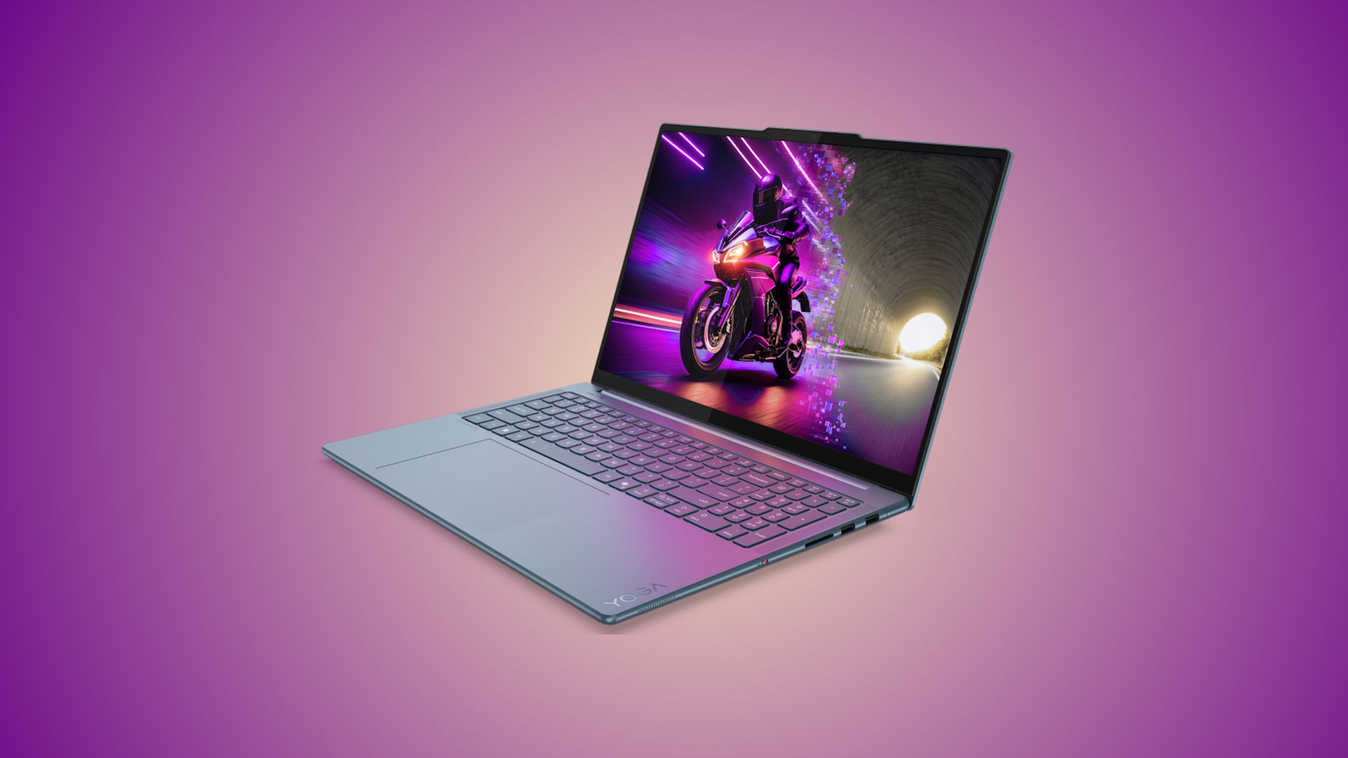
The Lenovo Yoga Pro 9i Gen 10 Aura Edition blends raw power and sophistication in a sleek Luna Grey chassis. Featuring Intel Core Ultra (Series 2) chips and RTX 50 Series GPUs, it delivers elite performance for AI and creators, elevated by a stunning 1000-nit Tandem OLED 165Hz display. Its unique "Aura" features automate privacy, focus, and wellness, making it the ultimate 2026 Windows rival to the MacBook Pro.

Slide 9
The Lenovo Yoga Pro 9i Gen 10 Aura Edition blends raw power and sophistication in a sleek Luna Grey chassis. Featuring Intel Core Ultra (Series 2) chips and RTX 50 Series GPUs, it delivers elite performance for AI and creators, elevated by a stunning 1000-nit Tandem OLED 165Hz display. Its unique "Aura" features automate privacy, focus, and wellness, making it the ultimate 2026 Windows rival to the MacBook Pro.

Slide 10
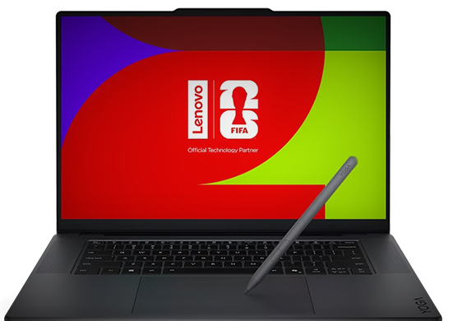
SPECIFICATIONS
Intel® Core™ Ultra 9 285H Processor (efficiency cores up to 4.50 GHz, performance cores up to 5.40 GHz)
WiFi 7 2x2
Bluetooth® 5.4
Starting from 1.32 kg
4 x speakers: 2 x 2W tweeters, 2 x 2W woofers
GPU para laptop NVIDIA® GeForce RTX™ 5070 8GB GDDR7
Memory
64 GB L
Íon de lítio recarregável com 4 células 84 Wh
3 Years Premium Care
170W Slim 30% PCC 3-Pin AC Power Adapter
Luna Backlit, Luna gray
6" 3,2K (3200 x 2000), Tandem OLED, com reflexo, sensível ao toque, HDR 1000 preto True, 100% Adobe RGB, 100% DCI-P3, 100% sRGB, 1.000 nits, 120 Hz, vidro
Price: $ 3,500.00

Slide 11


Slide 12
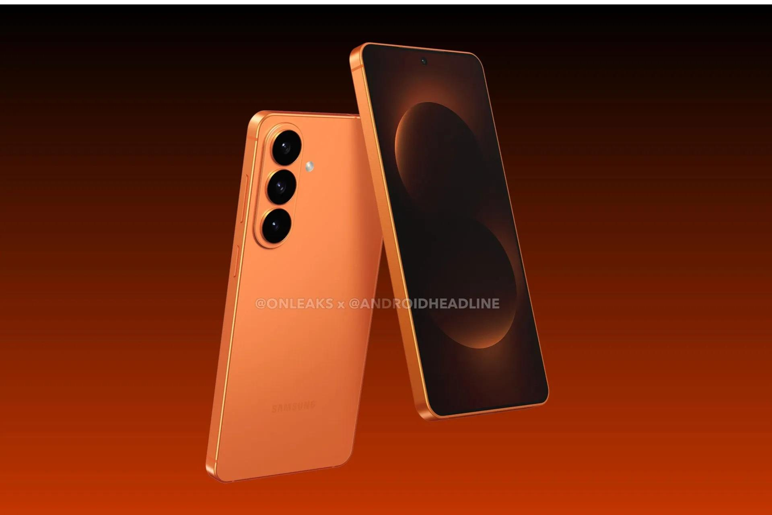
The Samsung Galaxy S26 line, launched in February 2026, includes the S26, S26+, and S26 Ultra, standing out for its Snapdragon 8 Elite Gen 5 processor, intense focus on artificial intelligence (Galaxy AI), and robust construction with Armor Aluminum. The models offer high-brightness screens, improved cameras, and the Ultra features na exclusive “Privacy Display

Slide 13
The Samsung Galaxy S26 line, launched in February 2026, includes the S26, S26+, and S26 Ultra, standing out for its Snapdragon 8 Elite Gen 5 processor, intense focus on artificial intelligence (Galaxy AI), and robust construction with Armor Aluminium. The models offer high-brightness screens, improved cameras, and the Ultra features na exclusive “Privacy Display

Slide 14


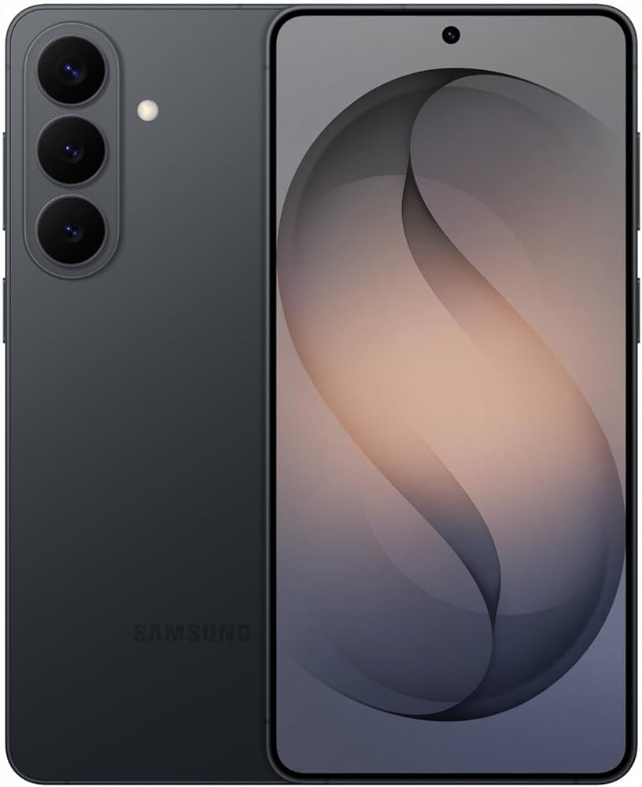
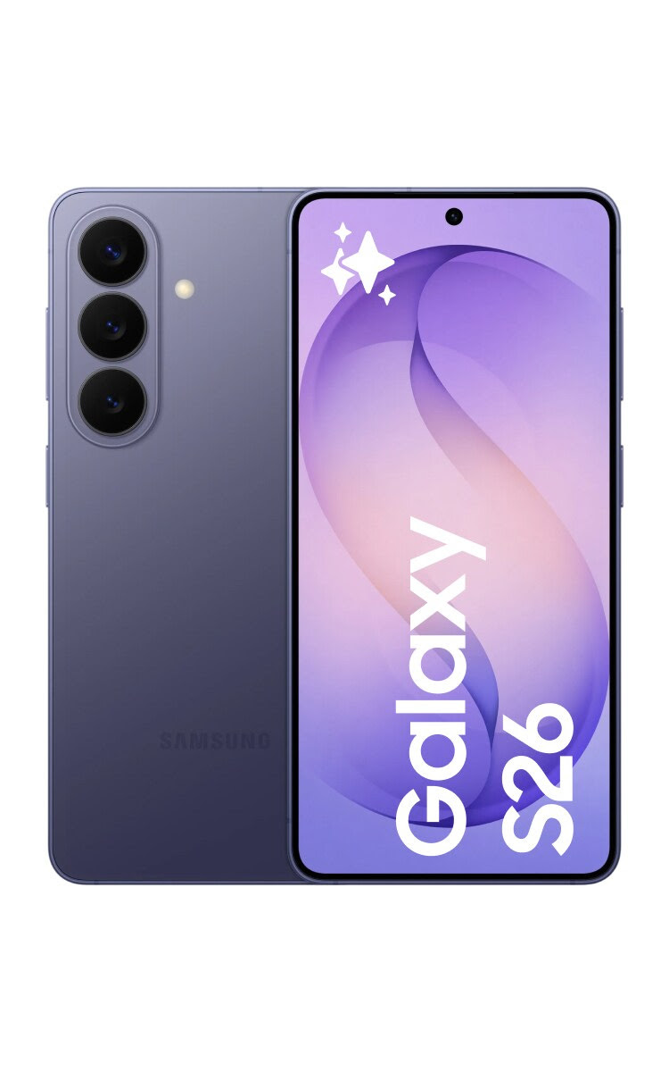
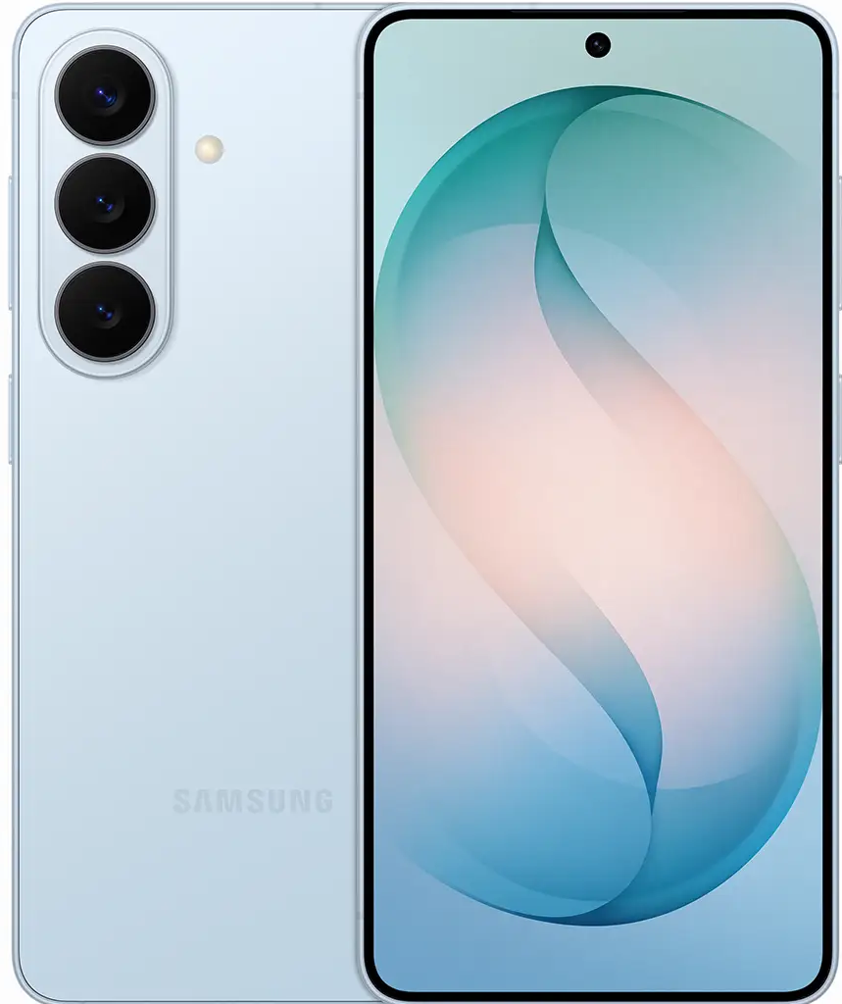
Coluors S26
PRICE:US$ 899,99
PRICE:US$ 899,99
PRICE:US$ 899,99

Slide 15


Slide 16
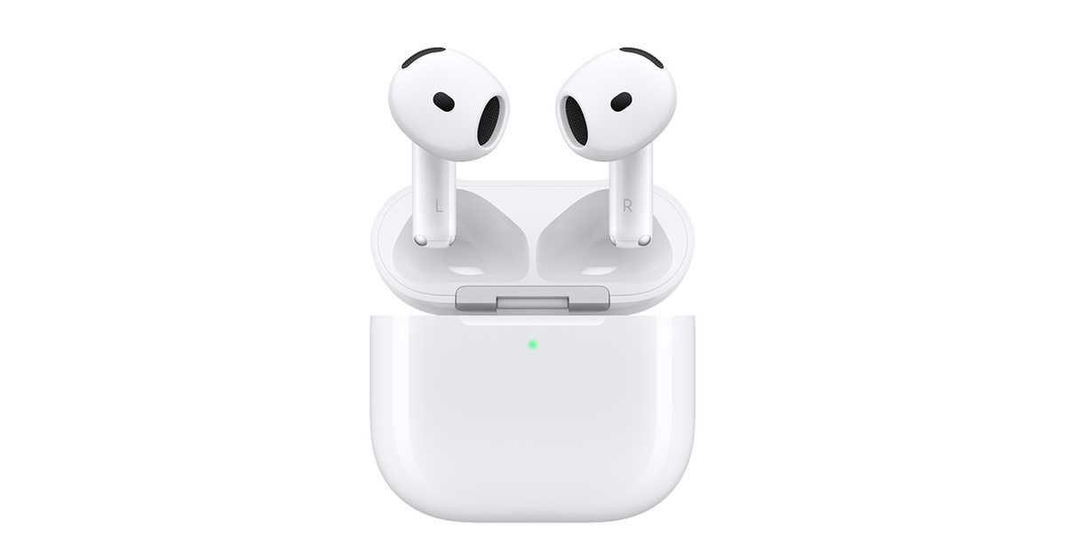

Slide 17
Price: 149 €

Slide 18
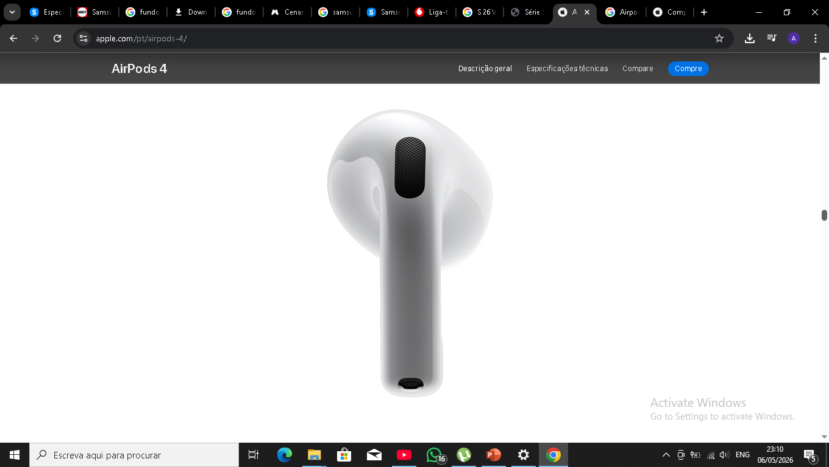

Slide 19
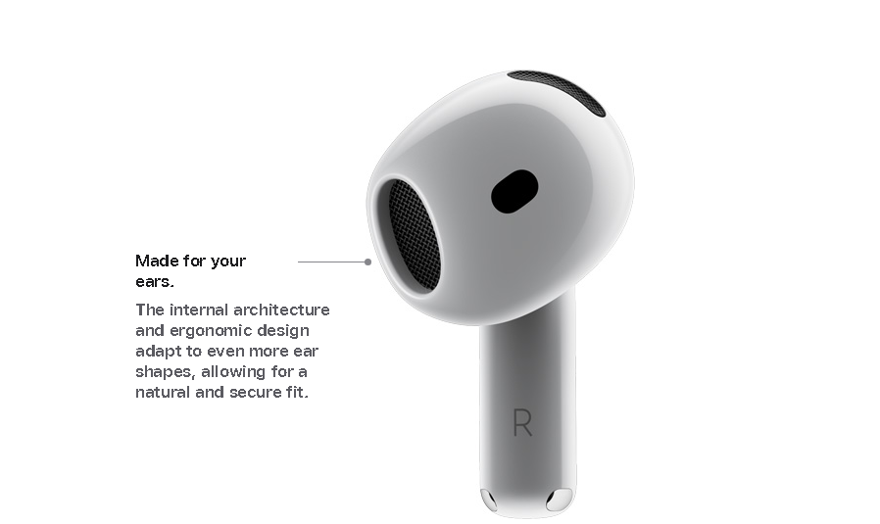

Slide 20
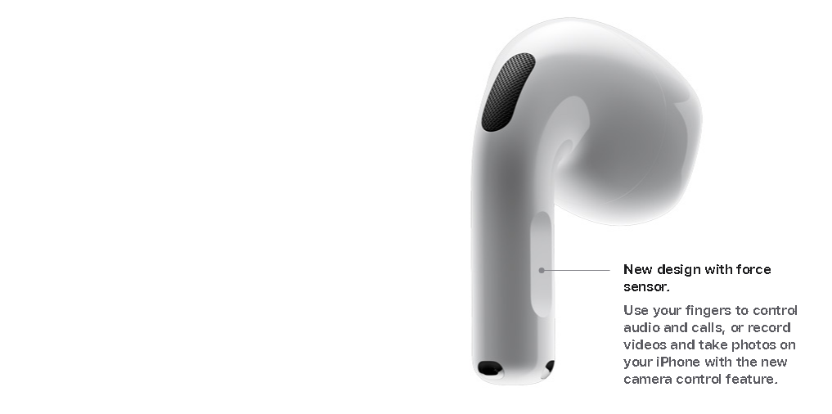

Slide 21

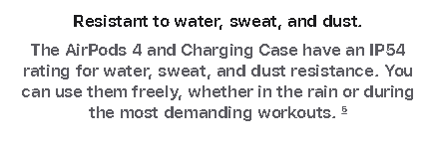

Slide 22
Contactos
Serviço ao cliente: 873904603 /
Site oficial : www.Digitalstoretech.mz
Email: Digitaltech2020@gmail.com

